Slide 1

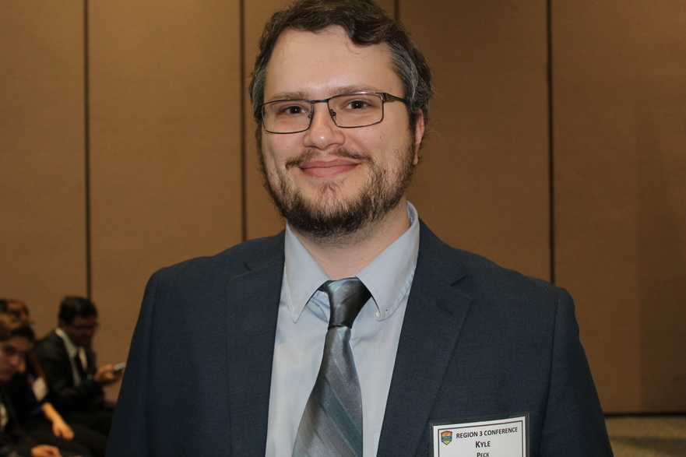

Contact Links
Stay up to date with what our FBLA chapter is up to!
Chapter’s instagram : westmeccentralcoding
Twitter: centralcoding
My Contact Information
Email: kyle.peck@west-mec.org
Phone: 623 - 209 - 8067
Notes:
Leticia

Slide 2

Notes:
Jarett

Slide 3

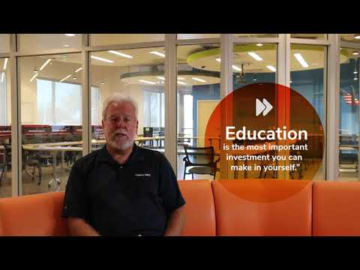
https://youtu.be/G5gDfP9_jgA

Slide 4

Administration
Troy Gabaldon
Campus Administrator
troy.gabaldon@west-mec.org
623-209-8052
Oversees Campus Operations
Ensures Quality Education
Ensures Safe Environment
Ensure FAA Compliance
Dr. Aaron Parsons
Assistant Campus Administrator
aaron.parsons@west-mec.org
623-209-8042
Student Accountability
Attendance
CTSO Activities
Behavior
Ensure Quality Education
Ensure Safe Environment
Notes:
Leticia

Slide 5
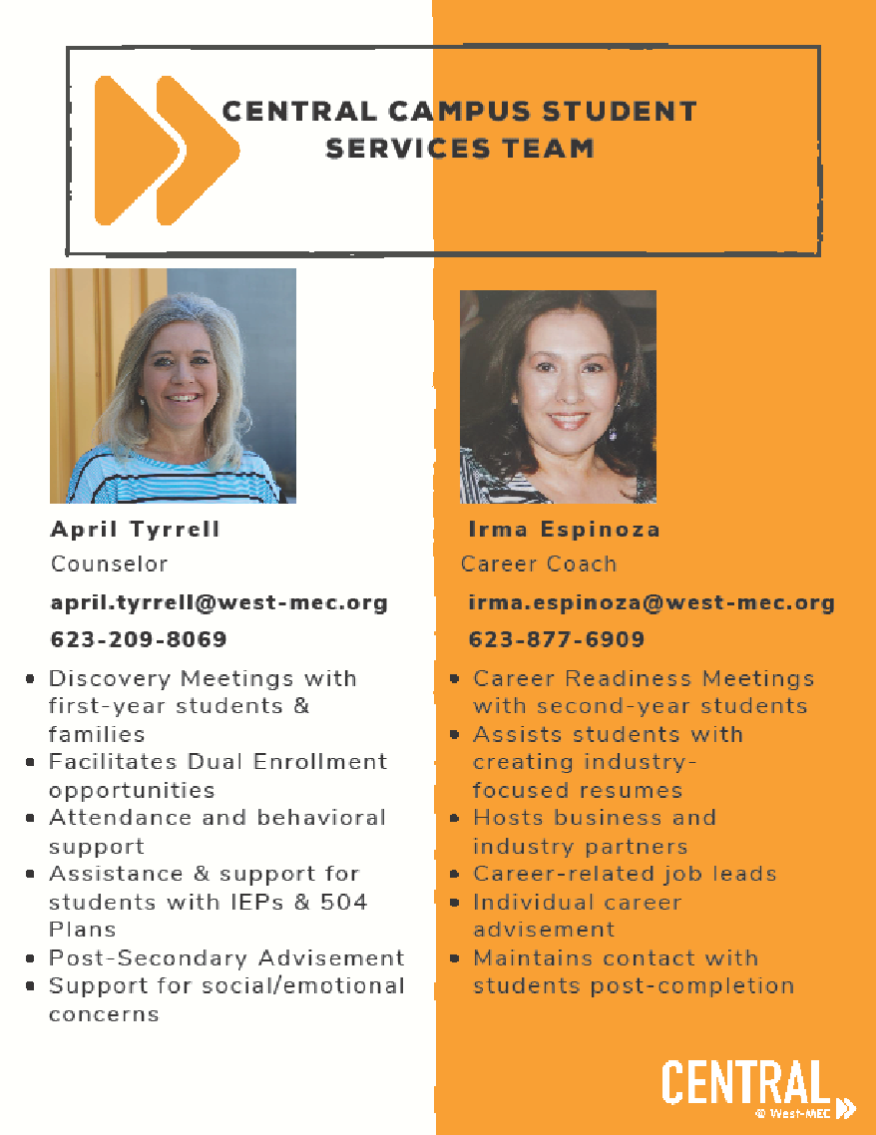
Student Services
April Tyrrell
Counselor
april.tyrrell@west-mec.org
623-209-8069
Discovery Meetings with first-year students & families
Facilitates Dual Enrollment opportunities
Attendance and behavioral support
Assistance & support for students with IEPs & 504s
Post - secondary Advisement
Support for social/emotional concerns
Irma Espinoza
Career Coach
irma.espinoza@west-mec.org
623-877-6909
Career Readiness Meetings with second-year students
Assists students with creating industry-focused resumes
Hosts business and industry partners
Career-related job leads
Individual career advisement
Maintains contact with students post-completion
Notes:
Leticia

Slide 6
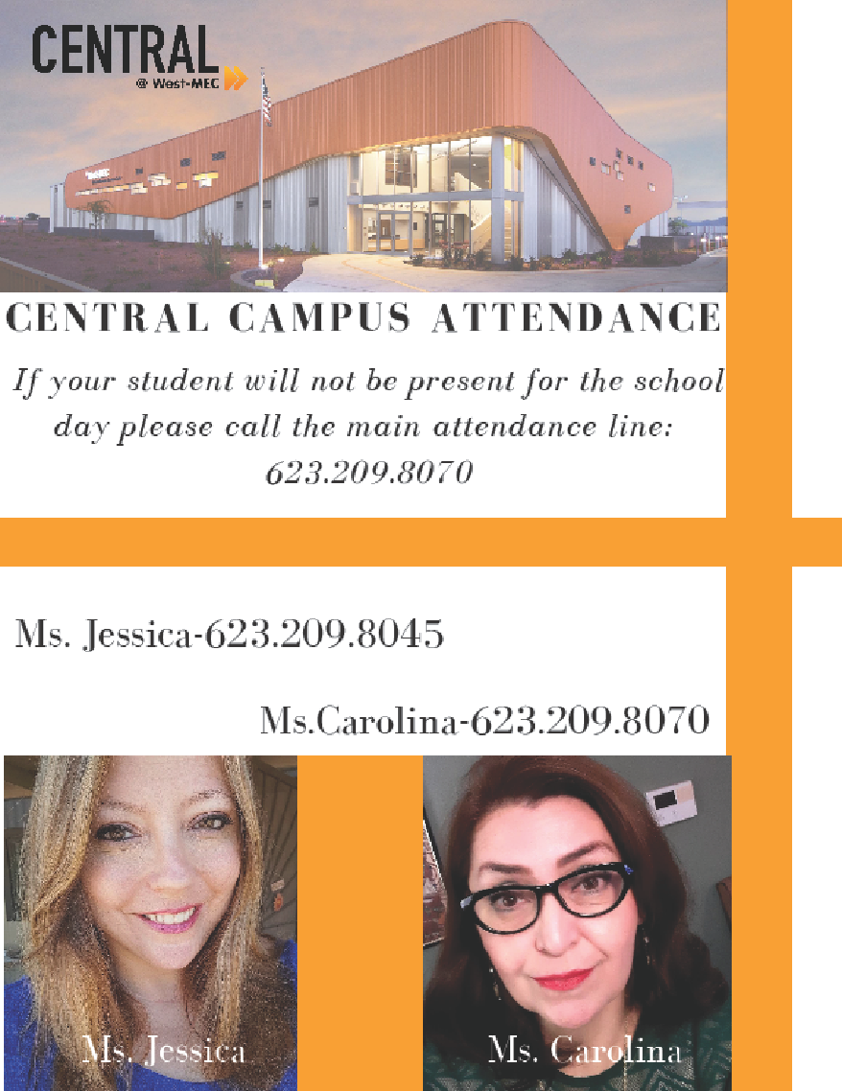
Attendance
and Front
Desk
CENTRAL CAMPUS ATTENDANCE
If your student will not be present for the school day please call the main attendance line:
623.209.8070
Ms. Jessica - 623.209.8045
Ms.Carolina - 623.209.8070
Notes:
Leticia

Slide 7
Links for Virtual Class
Every Day I will be sending a new link to the class through Google Classroom
Please take some time right now to either sign up on Google Classroom or write these codes down for later. (just incase I will also email these out after the meeting)
Session 1 students: gf5nvqo
Session 2 Students: 6qy5zpq
Notes:
Leticia

Slide 8
Schedule
We are going to have online classes everyday where you are expected to be in the call for the full 2.5 hours.
There will be small breaks and some time to stand up but we will be checking attendance 3 times per day
Session 1 will be in class from 1:00 PM to 3:30 PM
Session 2 will be in class from 4:00 PM to 6:30 PM
PLEASE LET ME KNOW IF THIS WON’T WORK FOR YOU ASAP!
Notes:
Leticia

Slide 9
Attendance
The right and privilege of attending West-MEC programs carries with it certain responsibilities on the part of both parents and students. It is important that parents and students recognize the direct relationship that exists between program success and regular, punctual attendance.
Because attendance is a valued employability skill, both verified and unverified absences count towards student attendance totals.
Notes:
Leticia

Slide 10
Resources
What you need for this class:
Somewhere to take notes, this can be a typed document online or a pen and paper notebook if you prefer
Mid range computer that you can use for programming.
If you need to borrow one from west-mec please email me to let me know
A webcam (any quality) for class
These we can’t lend out, please contact me with issues
Notes:
Leticia

Slide 11
Technology
If you do not have a laptop or a desktop at home that you can have uninterrupted access to for 2.5 hours a day for class please let me know
Also please email me if you do not have consistent access to internet at your home.
Notes:
Leticia

Slide 12
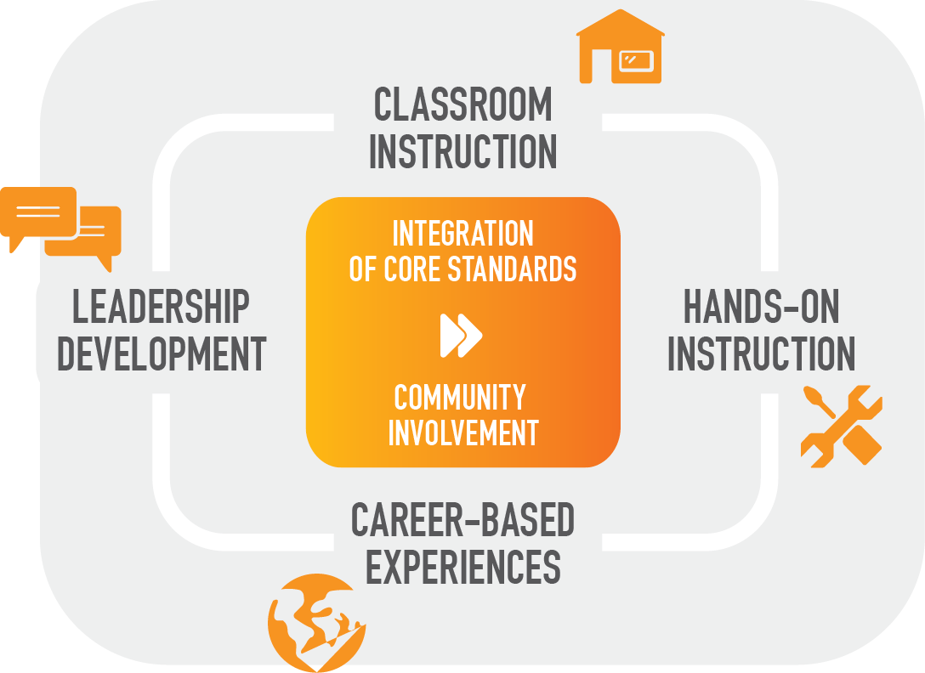
Notes:
Jarett

Slide 13
Leadership Development
Career & Technical Student Organizations - CTSO
Students active in CTSOs assume positive, productive roles in their community and are better prepared for a career and continuing education.
All students are expected to be active participants in their program CTSO.
Notes:
Jarett

Slide 14












ATTENDANCE
Notes:
Leticia

Slide 15
The following procedure will be implemented each semester:
Absence 1-2 Automated phone calls home, documented teacher/student conference Same as above, plus documented teacher/parent conference (via phone)
Absence 3 Same as above, plus documented teacher/parent conference (via phone)
Absence 4 Documented letter detailing absences sent home, teacher and counselor work together with parents/students to discuss strategies for improved attendance
Absence 5-6 Automated phone calls home
Absence 7 Documented teacher/parent conference (via phone or in-person)
Absence 8 Documented administrator contact with parents/guardians and student to develop an attendance behavior contract
Absence 9 Documented administrator/teacher refer to attendance behavior contract
Absence 10 Student may be withdrawn from the program if in violation of his/her attendance behavior contract. Due process will be followed
Student may be withdrawn from the program if in violation of his/her attendance behavior contract. Due process will be followed
Notes:
Leticia
Needs Updated

Slide 16
ATTENDANCE
Attendance Line Phone Number
Carolina Yanez (623) 209 - 8070
Building B Front Desk
Jessica WIlliams (623) 209 - 8045
Please do not call your son/daughter or their instructor on their
phone during class time for an early departure.
We ask that you please call the Attendance Phone Number and we will communicate and early departure to your son/daughter.
Notes:
Leticia

Slide 17




CONDUCT
Notes:
Jarett

Slide 18
Code Of Conduct
West-MEC’s programs replicate the work environment. Students are expected to conduct themselves as mature and professional employees at all times. A West-MEC student demonstrates:
Attendance Integrity
Engagement Pride
Respect Leadership
Each student is expected to respect the rights of classmates, teachers and other school personnel. Students who violate the rights of others, or who violate rules and regulations of the district, are subject to appropriate disciplinary measures designed to correct their own misconduct.
Notes:
Jarett

Slide 19
Student Parking
Parking in a West-MEC campus lot is a privilege, not a right. Students who drive to school must have their vehicle registered and will obtain a parking permit upon completing the form they will receive the first week of classes.
To obtain a parking permit, you must have a valid driver’s license, current vehicle registration and current proof of insurance.
The District may conduct routine patrols of student parking lots and inspections of the interiors or exteriors of student automobiles on school property whenever a reasonable suspicion that illegal or unauthorized materials are contained inside the automobiles.
Vehicles must be driven in a safe and orderly manner entering, exiting, and on district property as well as neighboring business partners' properties.
Notes:
Jarett

Slide 20
Student Parking
Student Parking and Campus Entry:
Follow the cones which indicate the pathing expected on campus. Vehicles will be asked to take an immediate right when entering campus and perform a loop. This is the reduce congestion and aids in smooth traffic flow.
West-MEC is a closed campus, student must check in/out through office
Notes:
Jarett
Needs Updated

Slide 21
Dress Code
Because our programs replicate the work environment, student uniforms and following the dress code policy is an expectation in all West-MEC programs.
Students are required to be in uniform everyday unless otherwise informed by their instructor.

Slide 22
STUDENT SERVICES
Notes:
Denise

Slide 23
Discovery Meetings
Discovery Meetings are individual meetings with 1st year students and their parents to set individual goals. Discovery Meetings are part of the career development that deliberately guide students and families to create intentional and meaningful college and career ready pathways. Discovery Meetings are ideally held with students and parents, during West-MEC time, and are about 30 minutes in length.
Notes:
Denise

Slide 24
SPECIAL SERVICES
Students with disabilities enrolled in West-MEC Central Programs will be provided instructional supports as outlined in their Individual Education Plan (IEP)
(IEP and 504 documents will be requested from the home high school)
Notes:
Denise

Slide 25
CAREER SERVICES COACH Irma Espinoza
Notes:
Brian

Slide 26
Career Services Coach
RESUMES
COVER LETTERS
INTERVIEW SKILLS
MOCK INTERVIEWS
INDUSTRY PARTNER INTERACTIONS
ADVISORY COUNCIL
INTERN/ EXTERNSHIP, JOB SHADOWING
CAREER PLACEMENT ASSISTANCE
STUDENT AMBASSADORS
Notes:
Use key terms from the job ad and incorporate them into the students resume (priority)
Then go into word banks with AZCIS

Slide 27
2019/ 2020 Touchpoints
RESUME BUILDING
SOFT SKILLS TRAINING
PATHWAYS 2 SUCCESS ( Seniors)
INTERVIEW PREPARATION
EXIT INTERVIEWS
CTSO/ SKILLS
FAST FORWARD SESSION
Notes:
Use key terms from the job ad and incorporate them into the students resume (priority)
Then go into word banks with AZCIS

Slide 28
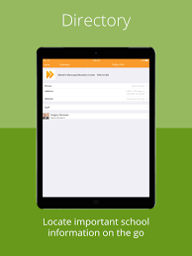


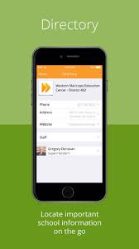

COMMUNICATION
Download the West-MEC Mobile APP
Notes:
Leticia

Slide 29

Parent Engagement
Please follow us on Facebook
Event information
Program News and photos
Calendar reminders
Special Events
And much more!
Notes:
Leticia

